Slide 1
Detailed Overview of COVID 19 for
Uttar Pradesh
By Manav Jangid

Slide 2
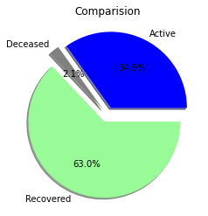
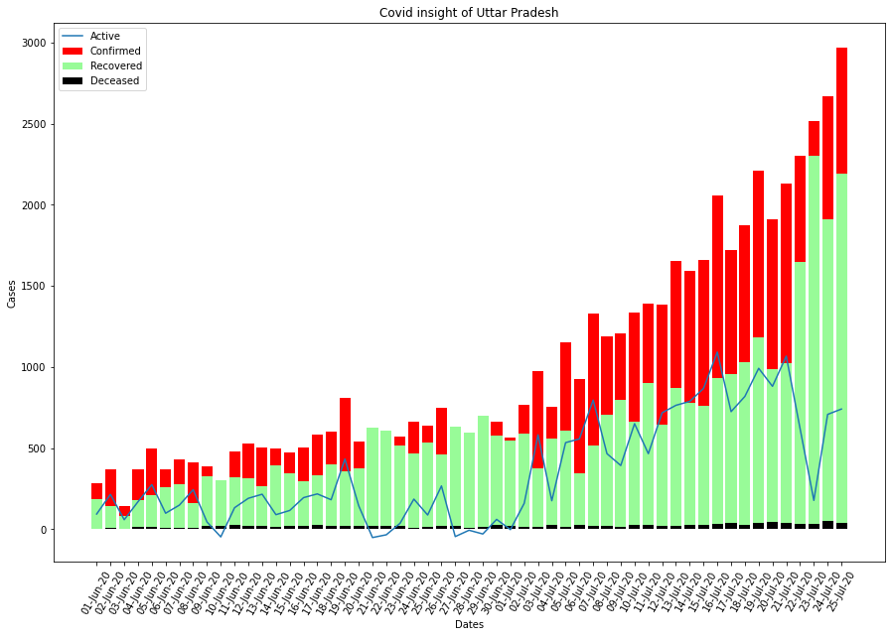
Figure’s Showing Condition’ s in
Uttar Pradesh:-

Slide 3
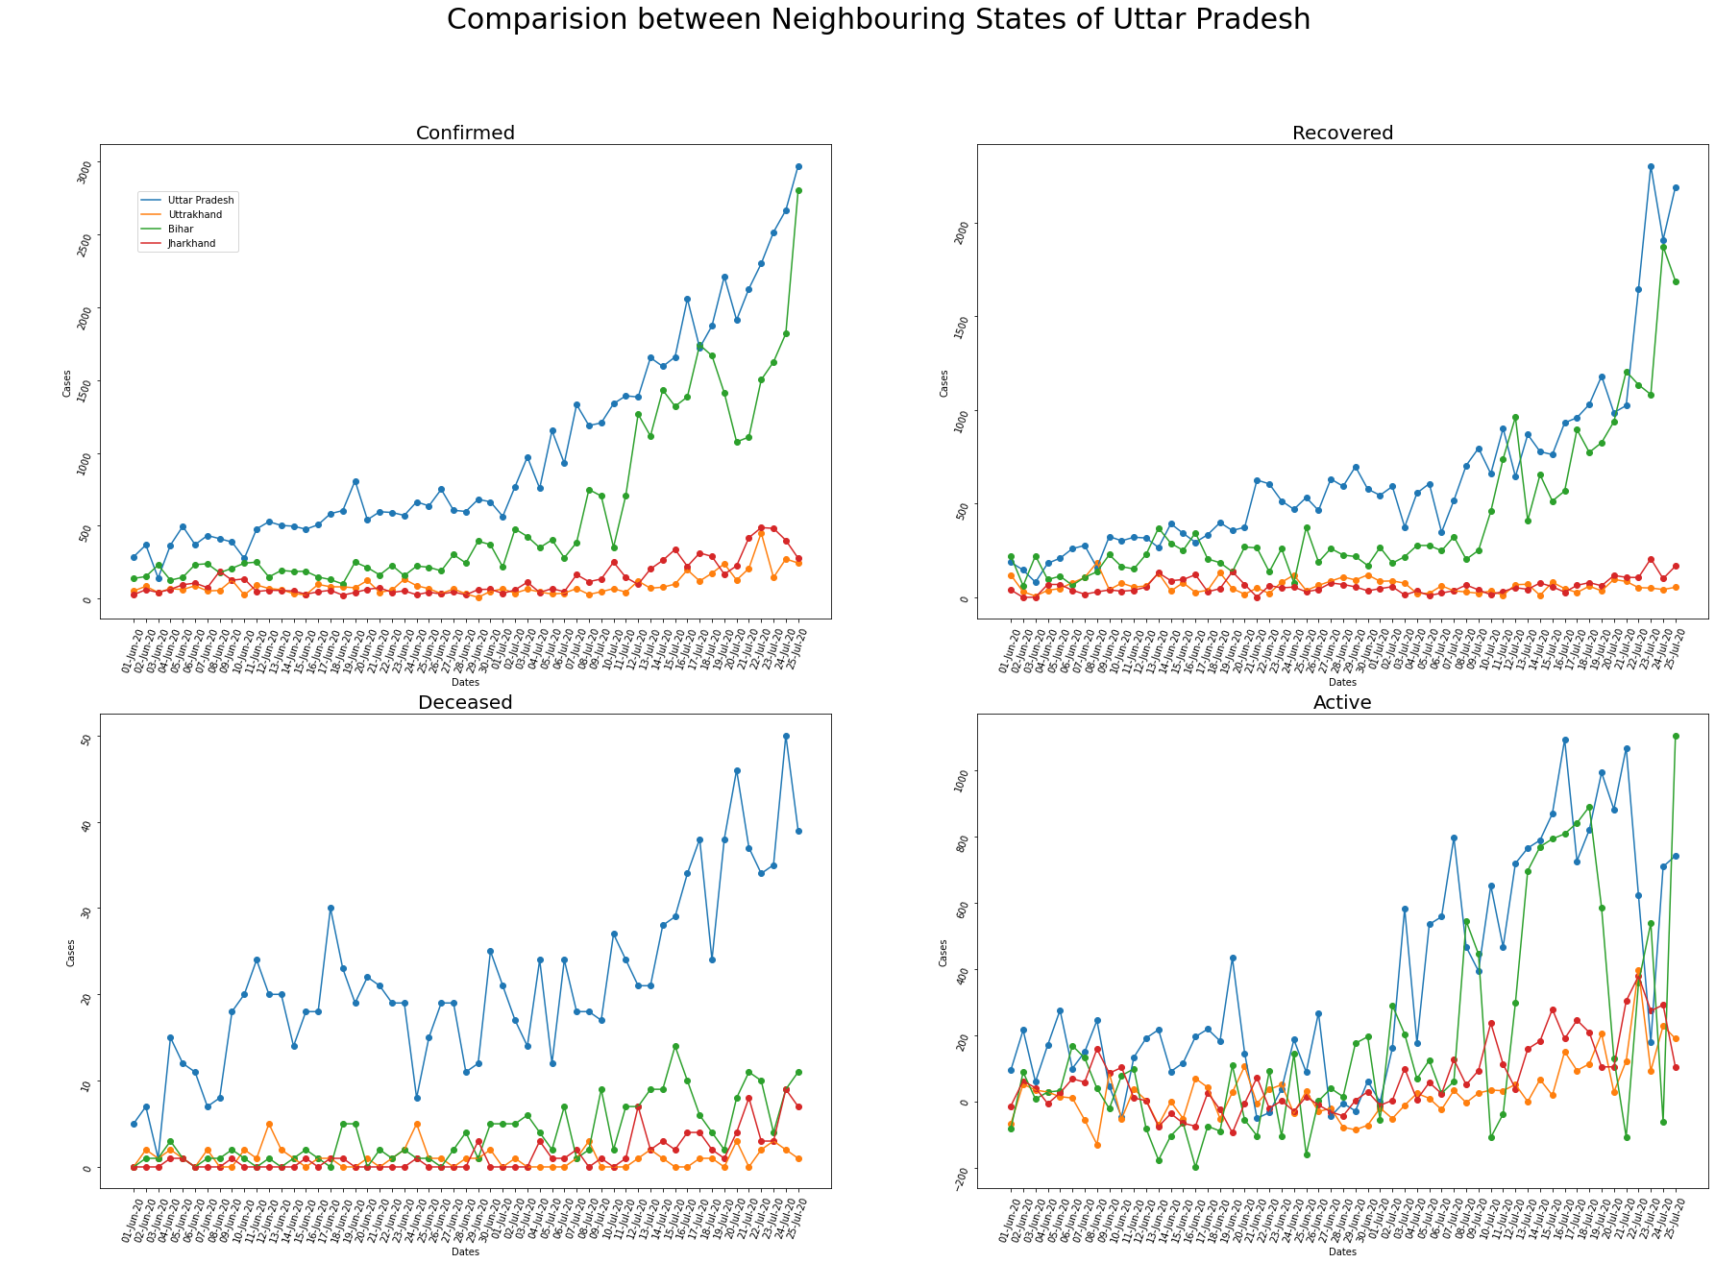

Slide 4
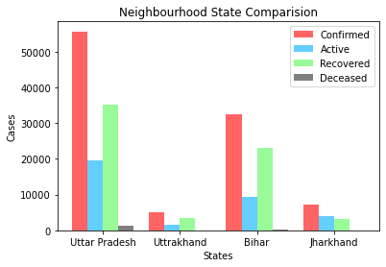
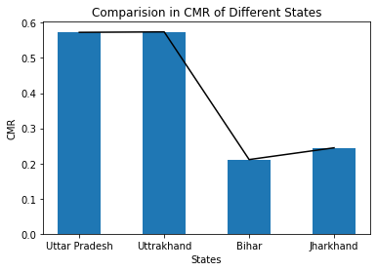
Note:- All the data taken is
Between 1 June 2020
to 25 July 2020.

